Slide 1


<Name>
<Date>

Slide 2

Outline
Executive Summary
Introduction
Methodology
Results
Conclusion
Appendix

Slide 3
Executive Summary
Summary of methodologies
Data Collection: through both APIs and web-scraping techniques
Data Wrangling
Exploratory Data Analysis: through SQL & data visualization
Interactive geospatial analytics using Folium
Machine learning for predictive classification
Summary of all results
Exploratory data analysis insights & screenshots
Geospatial analysis insights & screenshots
Predictive classification results & conclusions

Slide 4
Introduction
Project background and context
While competing companies advertise Falcon 9 rocket launches at a price point upwards of $160 million, Space X offers a far cheaper option costing only 62 million. They are able to do this as the first stage of their builds are reusable from launch to launch, cutting down operation costs dramatically. However, this reusability relies on extra factors, and is not a guarantee. As a result, if the return and thus the reusability of the first stage can be predicted accurately, Space X may alter factors in their prep to guarantee more future success, and other companies may also use these techniques to aid them in bidding wars over rocket launches.
Problems you want to find answers
What are the most important variables when determining the success or failure of an individual rocket launch?
Are there geospatial conditions that may affect the success or failure of a rocket launch?
What is the best and most practical machine learning technique to make these predictions?

Slide 5

Section 1

Slide 6
Methodology
Executive Summary
Data collection methodology:
The data was collected first using the Space X API, and then additional information was gathered through traditional web scraping techniques via Wikipedia
Perform data wrangling
One hot encoding: categorical landing outcome variable was transformed into 1,0 values to prepare for future machine learning and analytics
Perform exploratory data analysis (EDA) using visualization and SQL
Perform interactive visual analytics using Folium and Plotly Dash
Perform predictive analysis using classification models; how to

Slide 7
Data Collection
The process of collecting information for this project involved the use of both Space X’s REST API as well as traditional web scraping techniques that utilized relevant Wikipedia pages. Without the use of both sources, the data used would have been insufficient for the tasks at hand.
The resulting tables were able to be combined using the reference key of flight number
Information Collected via API: flight number, date, booster version, payload mass, latitude and longitude of the launch site, the launch site name, serial numbers, the reuse count for the first stage of the launch, the number of flights, gridfins, legs, landing pad, block status, and the outcome of each individual launch.
Information collected via web scraping: flight number, date / time, payload, payload mass, orbit, customer, version booster, booster landing, and launch outcome.

Slide 8
Data Collection – SpaceX API
Link to Notebook
Request launch information from Space X API
Use pandas functions to transform request .json results to dataframe
Use lambda/custom functions to extract only the most necessary information in each dataframe entry
Using cleaned information create new dictionary
Turn this new dictionary into dataframe
Filter the dataframe to only include Falcon 9 launches
Replace missing values with the mean of the respective column
Export to CSV for future use

Slide 9
Data Collection - Scraping
Link to Notebook
Request launch information from Wikipedia
Create beautiful soup object out of HTML response
Acquire field names from HTML table header
Parse data via HTML tables and collect relevant information
Turn this collected information into dictionary
Create a dataframe from dictionary and export it as a .csv

Slide 10
Data Wrangling
Link to Notebook
To properly prepare for both analysis and machine learning, some changes needed to be made to the datasets. A key alteration was seen in the mission outcome field. Here there were multiple different types of mission outcomes pertaining to whether it was successful or not as a whole, followed by the manner this occurred (ocean return for instance). To simplify this, a training label was created to show simply if it succeeded or not, which would allow a machine learning process to determine between only one and zero, instead of seven or eight possible outcomes.
Load in csv as dataframe
Check datatypes of fields, check for nulls
Find number of launches on each site
Find the number of occurrences for each mission outcome
Create list of outcome types that are considered unsuccessful
Using the list create a landing outcome label (successful or unsuccessful) for future use
Export the wrangled data as a csv

Slide 11
EDA with Data Visualization
Notebook Link
Scatter plots were used to determine if there was any general relationship between variables
Bar charts were used to determine if any factor on average showed a correlation to the target variable
Line charts were used to show the relationship between time passing and the target variable
Flight Number vs. Payload - Scatter
Flight Number vs. Launch Site - Scatter
Payload Mass (kg) vs. Launch Site - Scatter
Orbit vs. Mean Success – Bar Chart
Flight Number vs. Orbit & Success – Scatter (Hued)
Payload vs. Orbit and Success – Scatter (Hued)
Date vs. Success Rate - Line

Slide 12
EDA with SQL
Notebook Link
The SQL Queries Performed:
Displayed the names of the unique launch sites in the space mission
Displayed 5 records where launch sites begin with the string 'CCA’
Displayed the total payload mass carried by boosters launched by NASA (CRS)
Displayed average payload mass carried by booster version F9 v1.1
Listed the date when the first successful landing outcome in ground pad was achieved
Listed the names of the boosters which have success in drone ship and have payload mass greater than 4000 but less than 6000
Listed the total number of successful and failure mission outcomes
Listed the names of the booster_versions which have carried the maximum payload mass. Use a subquery
Listed the records which will display the month names, failure landing_outcomes in drone ship ,booster versions, launch_site for the months in year 2015.
Ranked the count of landing outcomes (such as Failure (drone ship) or Success (ground pad)) between the date 2010-06-04 and 2017-03-20, in descending order.

Slide 13
Build an Interactive Map with Folium
Notebook Link
Markers were placed using launch sites latitude and longitude data, the following specifics allow for further understanding to be developed as to how or why certain areas may have more success
Used Circle, Popup, and Text Labels to mark all launch sites, also including the NASA Johnson Space Center
Each launch site had a cluster of smaller markers to visualize their success rates as individual locations
Colored lines were drawn from locations to notable points of interest – coasts and local infrastructure that could aid/impact the success of a launch site

Slide 14
Build a Dashboard with Plotly Dash
Notebook Link
Interaction Provided:
Dropdown menu allowing the user to select a launch site
Slider allowing the user to select the payload range for the launch sites they selected
Plots Provided:
Pie chart that shows the number of total launches that were successful for the selected launch site
Scatter chart that shows the relationship between payload mass vs. success rate for different booster versions

Slide 15
Predictive Analysis (Classification)
Notebook Link
Set a variable to the column containing the target variable
(class)
Use standard scaler to standardize the dataset
Split the dataset into test and training portions
Create a grid search for logistic regression model parameters
Evaluate the results of the model via print accuracy and confusion matrix
Repeat steps four and five for SVM, Decision Tree, and KNN classification
Compare results of all models, note the parameters of the best overall model
Report findings

Slide 16

Results
The results of the exploradtory data analysis will be displayed
Interactive analytics will be demoed in screenshots
Predictive analysis results will be displayed

Slide 17

Section 2

Slide 18
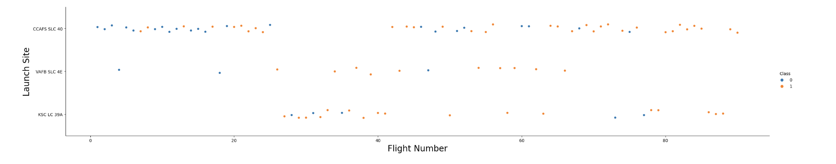
Flight Number vs. Launch Site
Given that flight number represents how late in the launch period the flight was, we can see that later flights tend to be more successful
CCAFS launch site seems to have the most launches, while operating primarily in the later portion of the process
KSC LC 39A appears to have the highest success rate – it also starts the latest

Slide 19
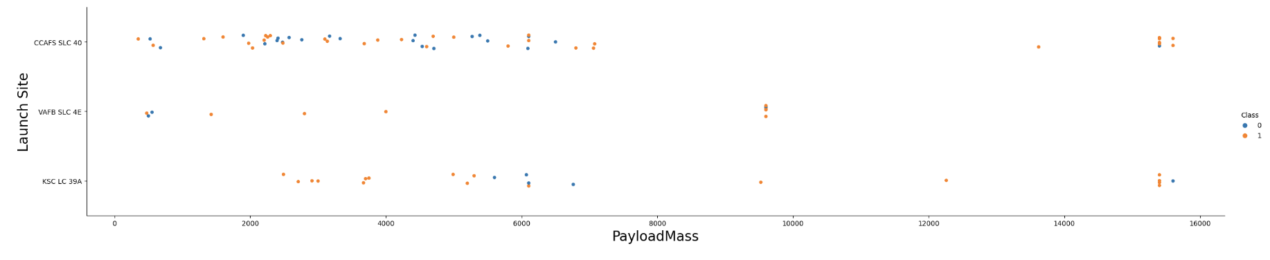
Payload vs. Launch Site
Higher failure seem to occur with lower payload masses, and the opposite with much higher payloads
CCAFS and KSC launch sites can take on much greater payload masses
KSC has a perfect success rate under 5500ish kg

Slide 20
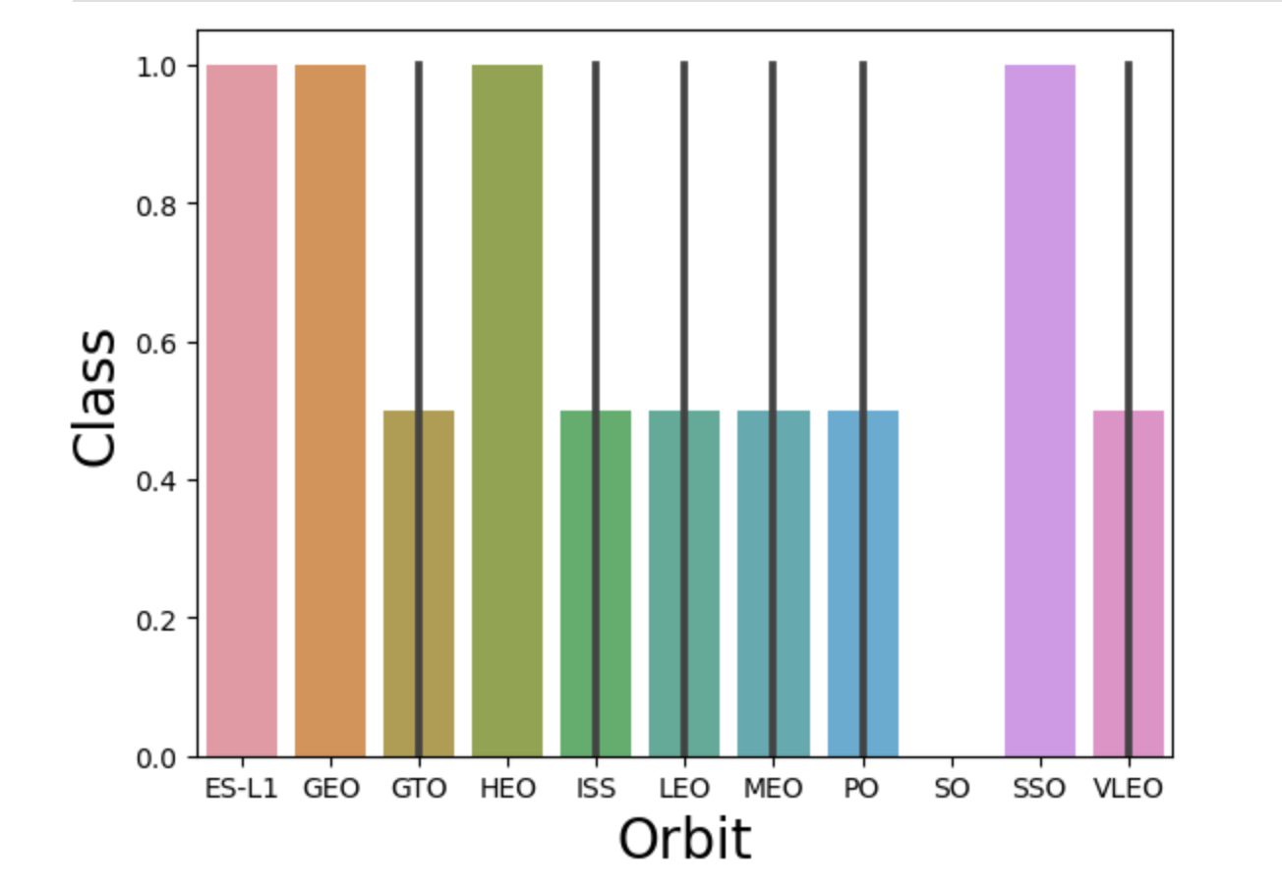
Success Rate vs. Orbit Type
Four orbits have a 100% success rate
ES-L1, GEO, HEO, SSO
Five orbits have a 50% success rate
GTO, ISS, LEO, MEO, PO VLEO
SO orbit had a 0% success rate

Slide 21
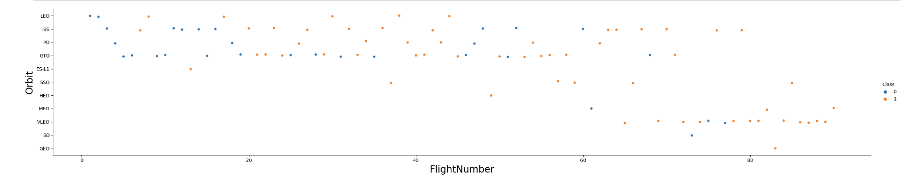
Flight Number vs. Orbit Type
LEO, ISS, PO, GTO, have very high failure rates earlier on
HEO, MEO, VLEO, SO, GEO flights all are not launched until the second half of the launch period

Slide 22
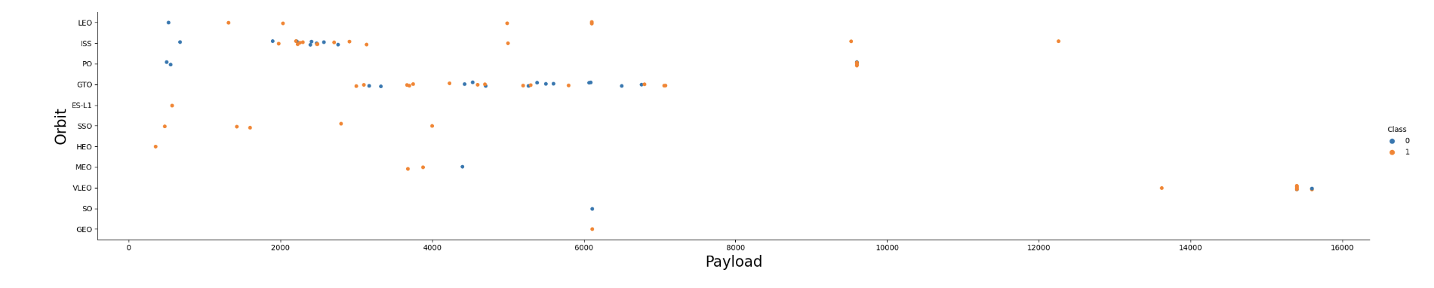
Payload vs. Orbit Type
THE SSO, despite its 100% success rate, never takes on a payload above 4000 kg
Although GTO orbits have a higher failure rate, they also appear to have one the highest median payload sizes

Slide 23
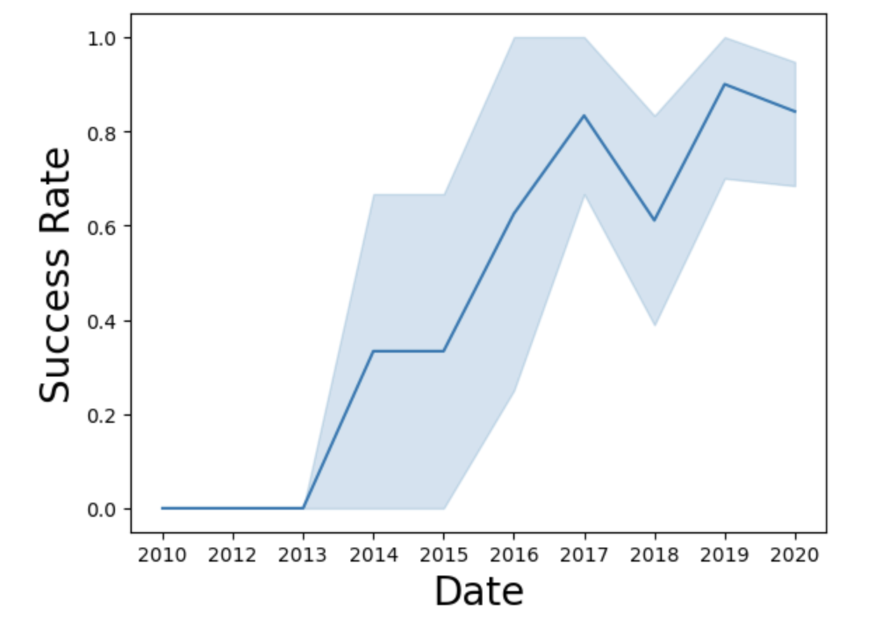
Launch Success Yearly Trend
Its clear that launch success improves dramatically with time, although a strange dip occurs in the earlier part of 2018

Slide 24
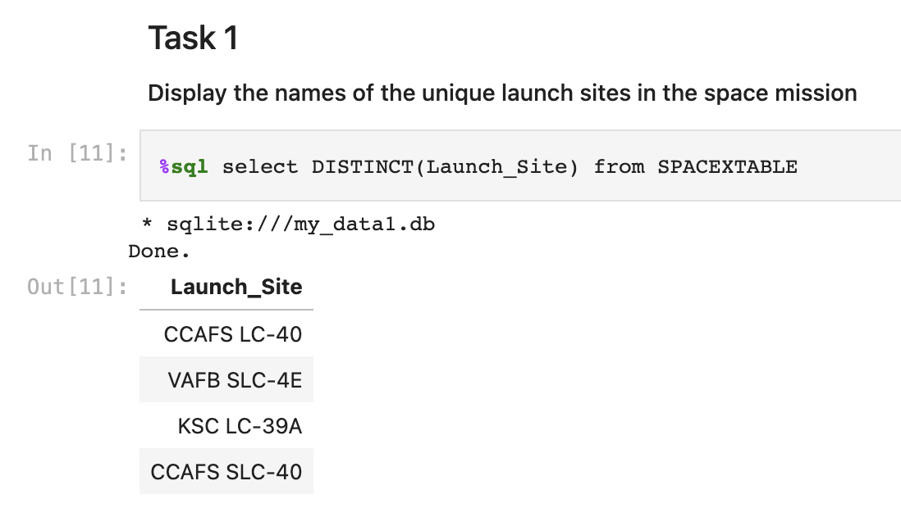
All Launch Site Names
All launch site names present within the SPACEXTABLE dataset

Slide 25
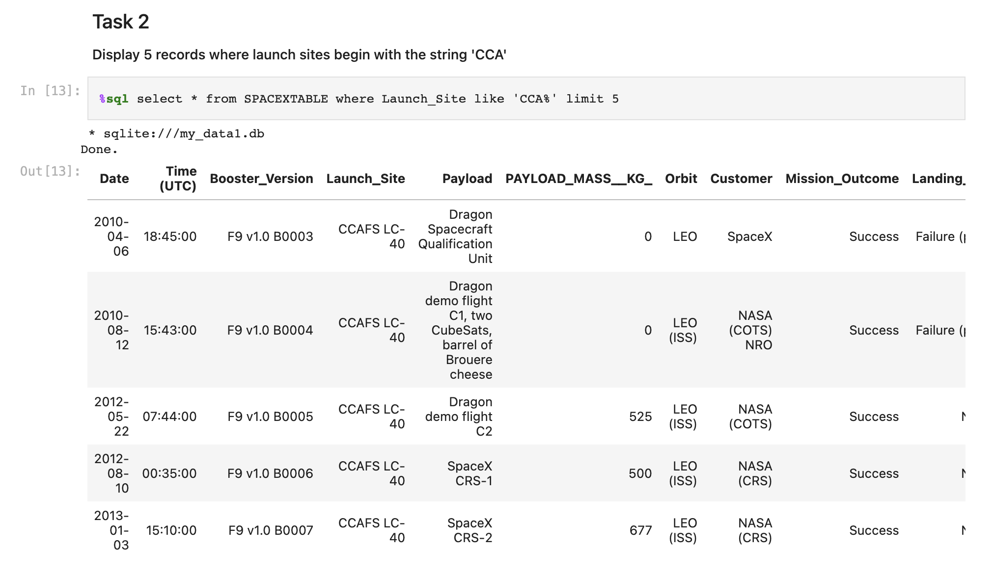
Launch Site Names Begin with 'CCA'
5 records where launch sites begin with `CCA`

Slide 26
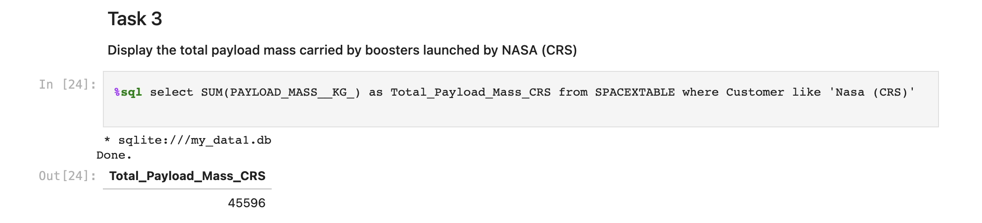
Total Payload Mass
Calculated total payload carried by boosters from NASA

Slide 27
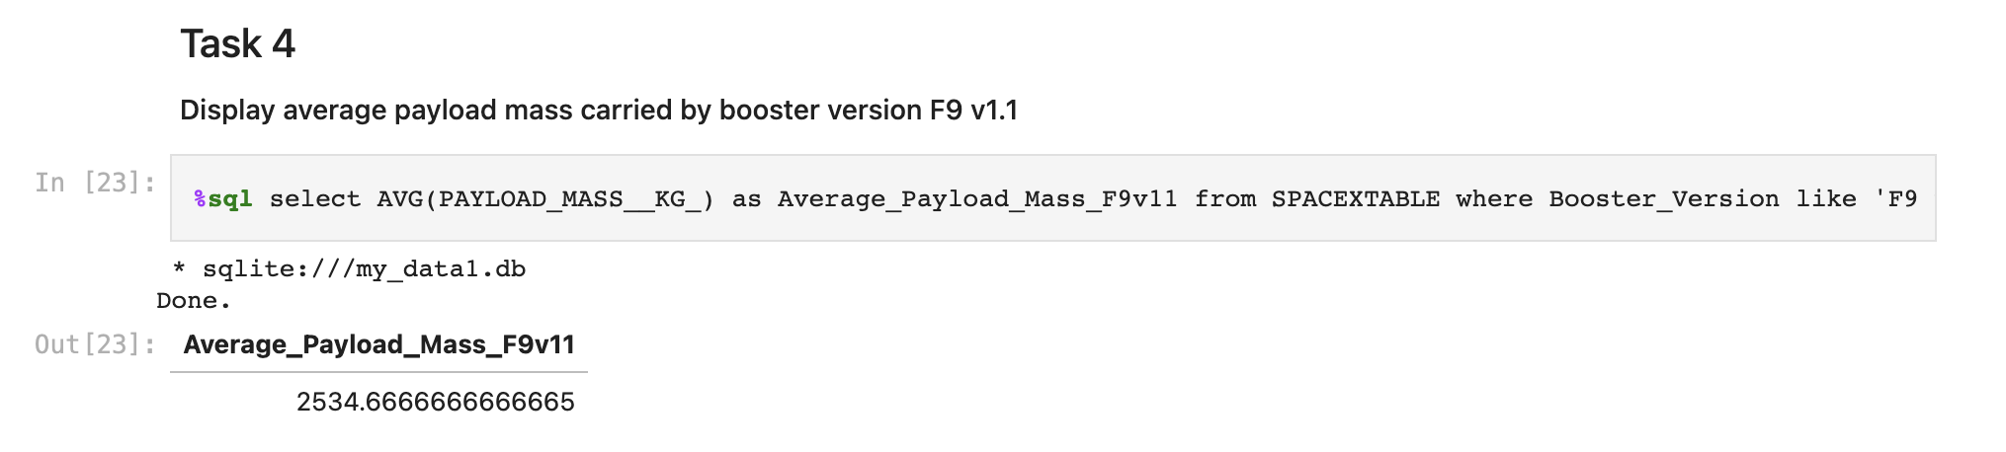
Average Payload Mass by F9 v1.1
Calculated the average payload mass carried by booster version F9 v1.1

Slide 28
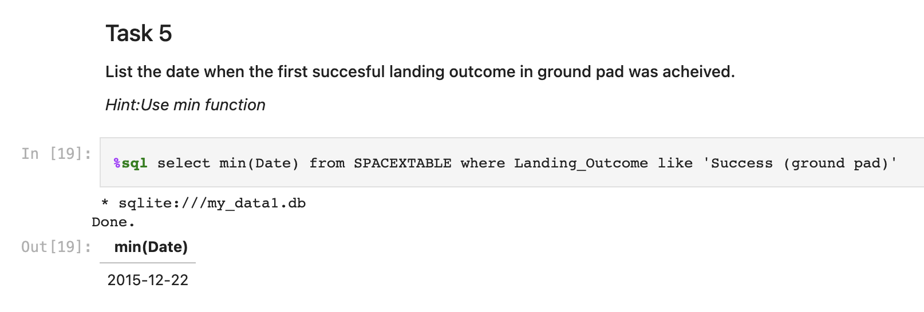
First Successful Ground Landing Date
Found the dates of the first successful landing outcome on ground pad

Slide 29
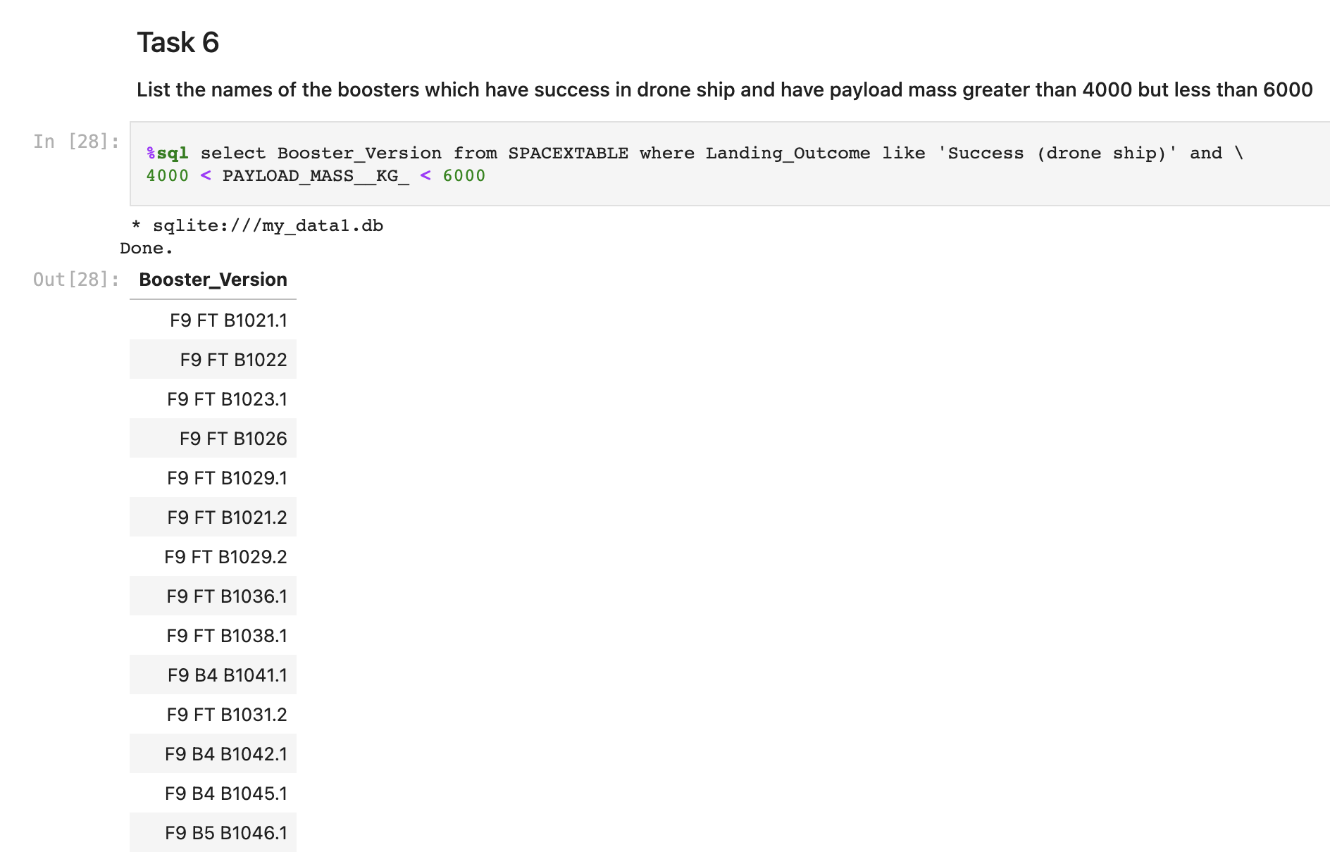
Successful Drone Ship Landing with Payload between 4000 and 6000
Listed the names of boosters which have successfully landed on drone ship and had payload mass greater than 4000 but less than 6000

Slide 30
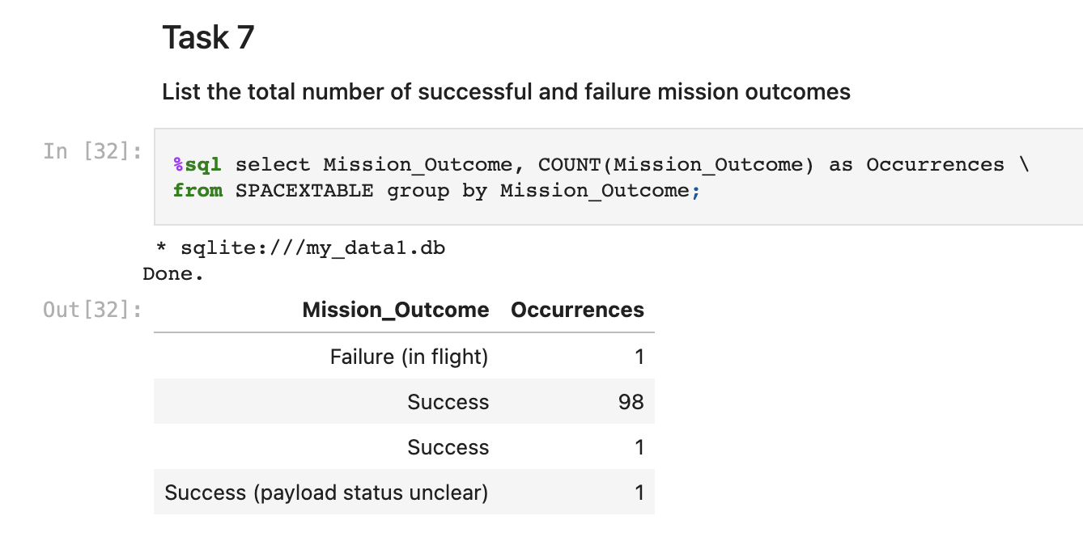
Total Number of Successful and Failure Mission Outcomes
Calculated the total number of successful and failure mission outcomes

Slide 31
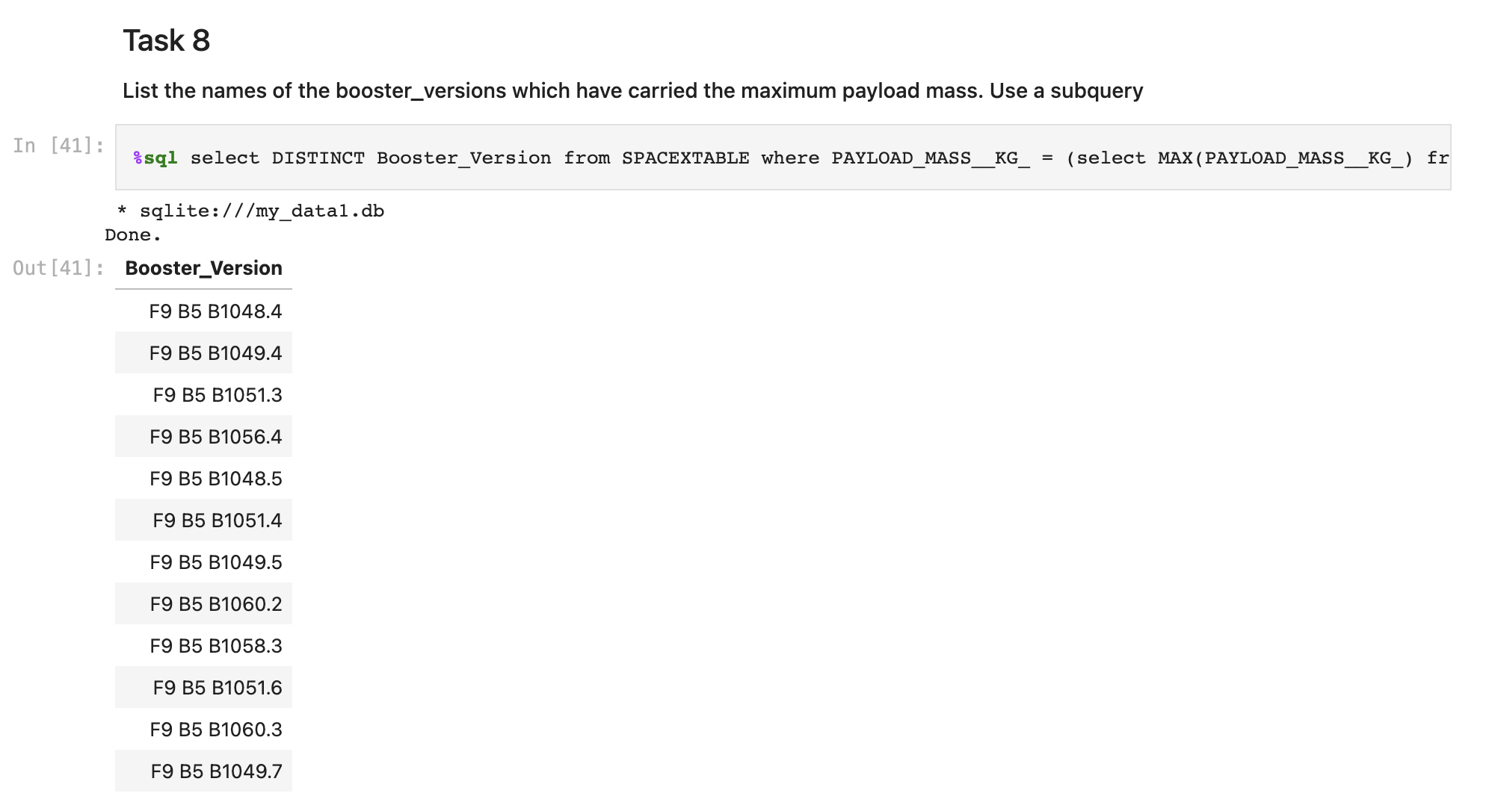
Boosters Carried Maximum Payload
Listed the names of the booster which have carried the maximum payload mass

Slide 32
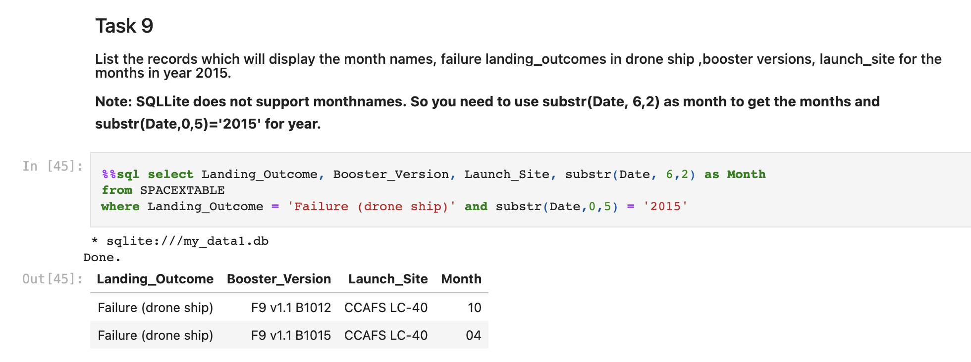
2015 Launch Records
Listed the failed landing_outcomes in drone ship, their booster versions, and launch site names for in year 2015

Slide 33
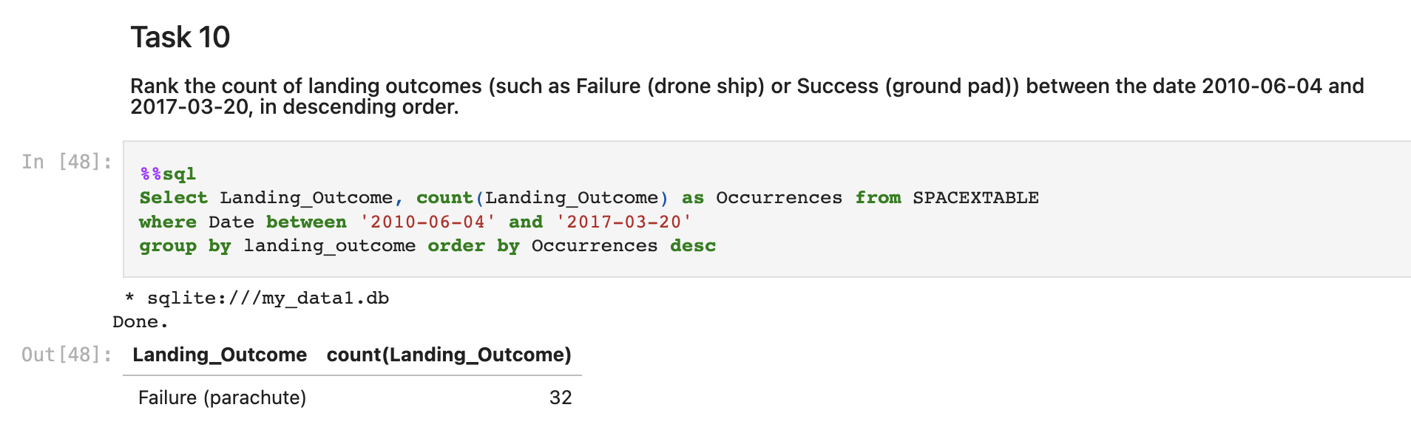
Rank Landing Outcomes Between 2010-06-04 and 2017-03-20
Ranked the count of landing outcomes (such as Failure (drone ship) or Success (ground pad)) between the date 2010-06-04 and 2017-03-20, in descending order

Slide 34

Section 3

Slide 35
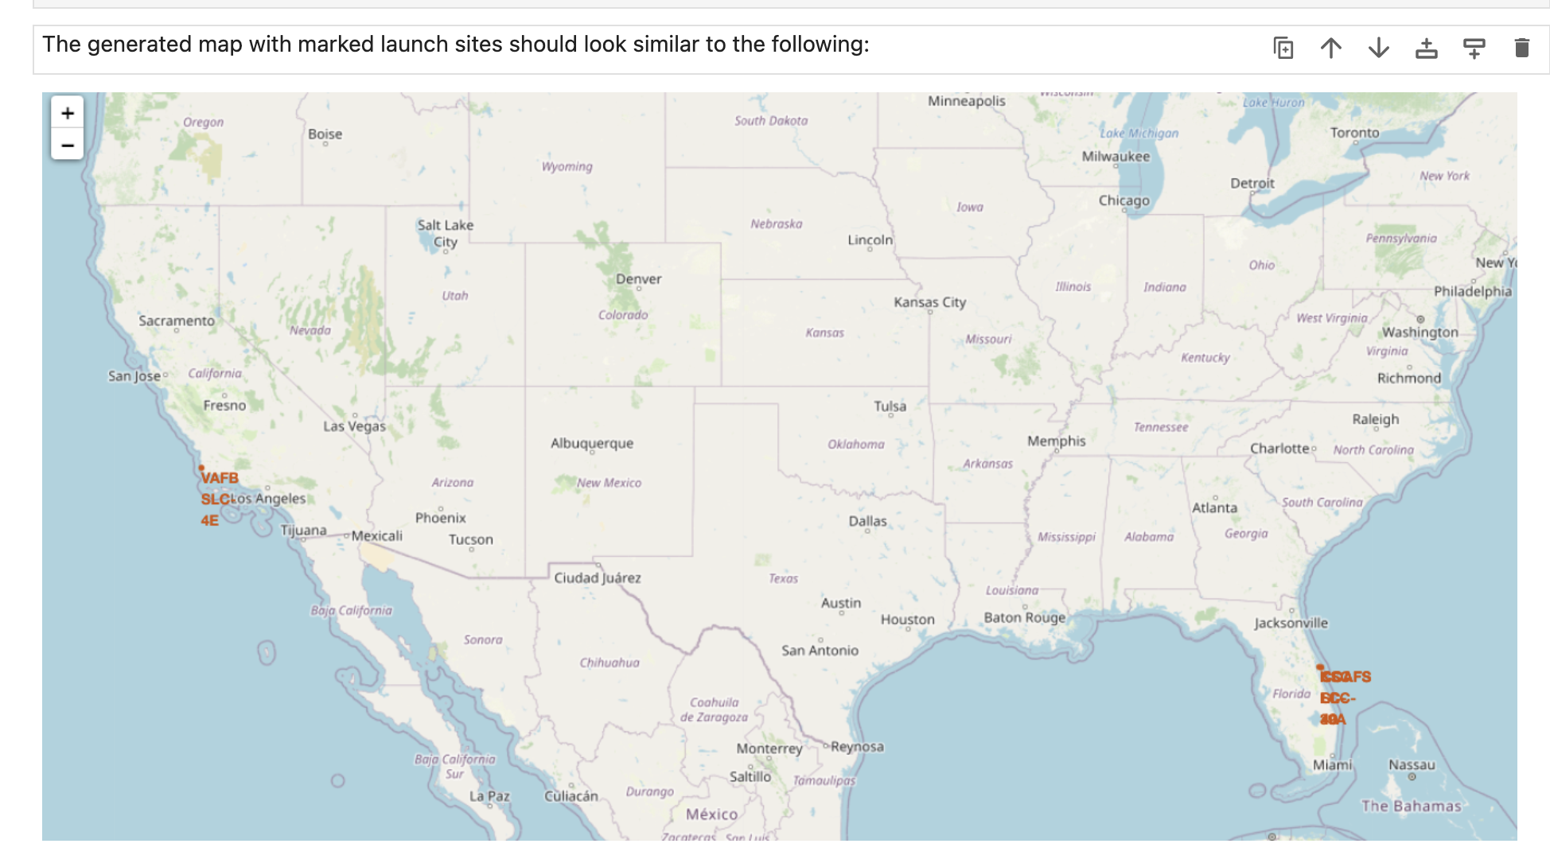
Launch Site Locations
Marked are the map are the locations of launch sites Space X has utilized
They are mostly on the southern coast of California, and the Atlantic Coast of Florida

Slide 36
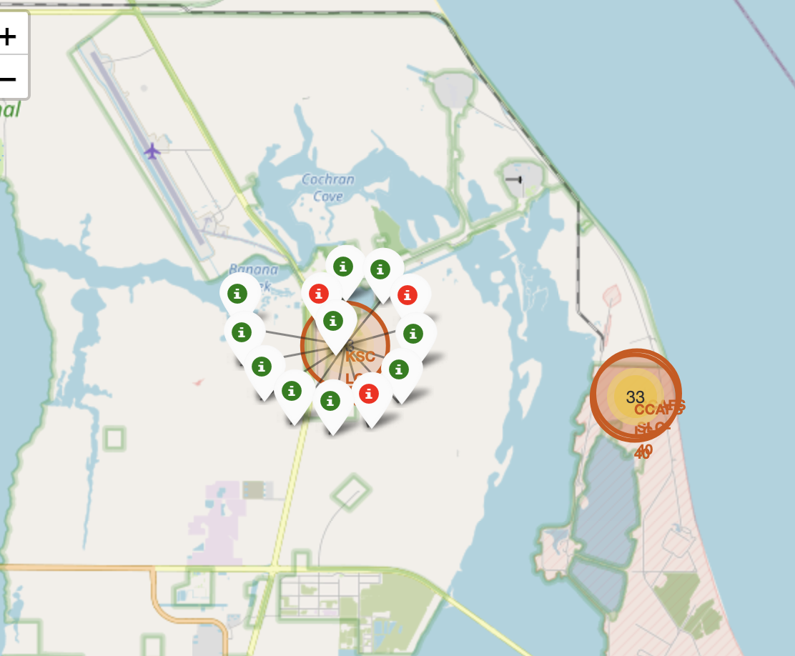
Cluster Displays
At each launch location, by clicking the user can see a display of all launches that occurred there and if they were successful or not (based on color)

Slide 37
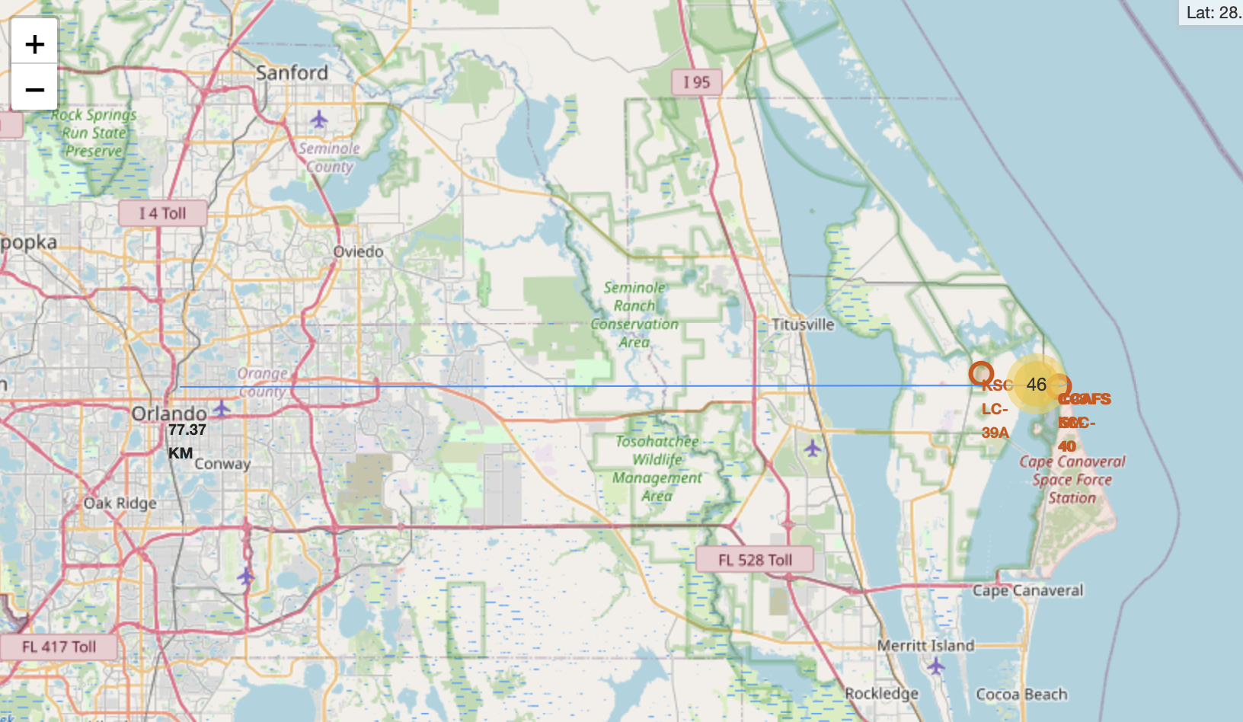
Showing Proximity to Nearby Infrastructure
Throughout making the folium map it was also important to show what infrastructure each location was near to – in this case Orlando and everything important there.

Slide 38

Section 4

Slide 39
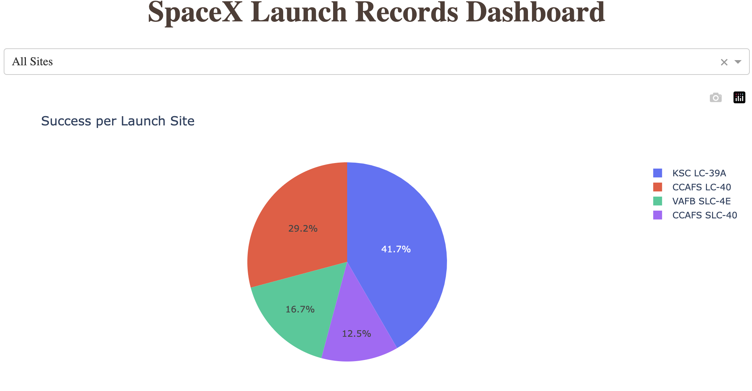
Share of total success per launch site
A pie chart displaying the share of successful launches each site is responsible for
KSC LC 39A being responsible for the most
CCAFS SLC 40 being responsible for the least

Slide 40
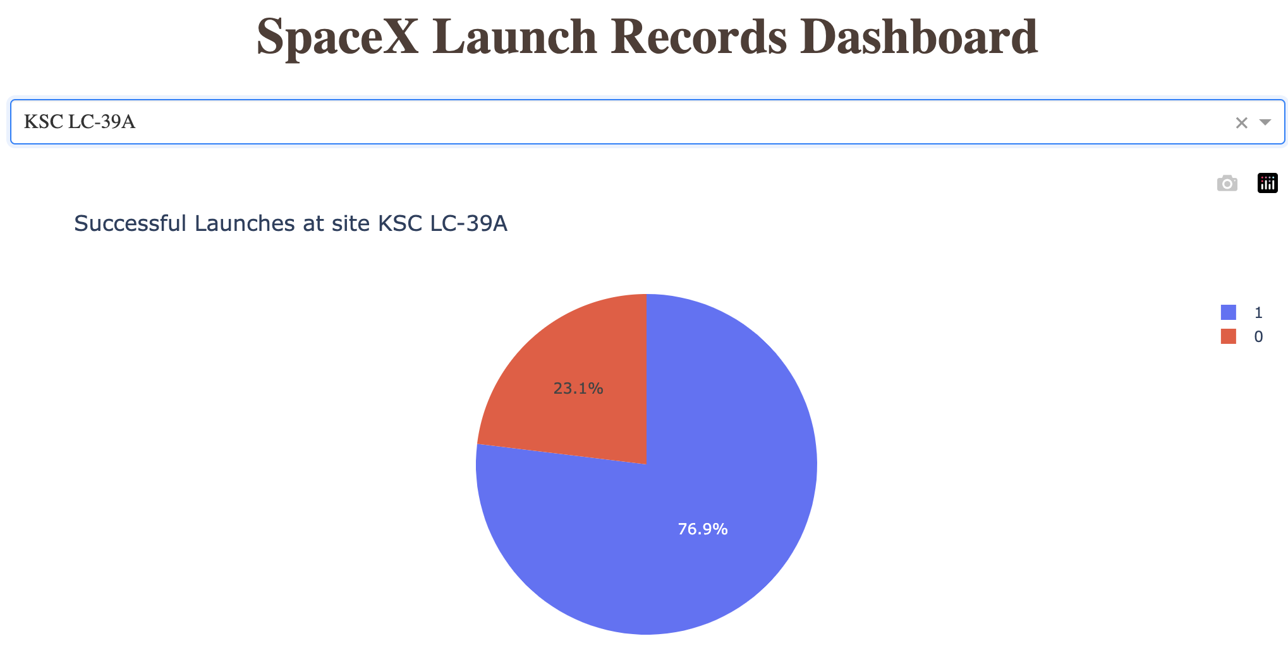
Piechart for the launch site with highest launch success ratio
The site responsible for the highest number of successful launches, was successful 76.9% of the time, which is also the largest percentage of favored outcomes among all sites

Slide 41
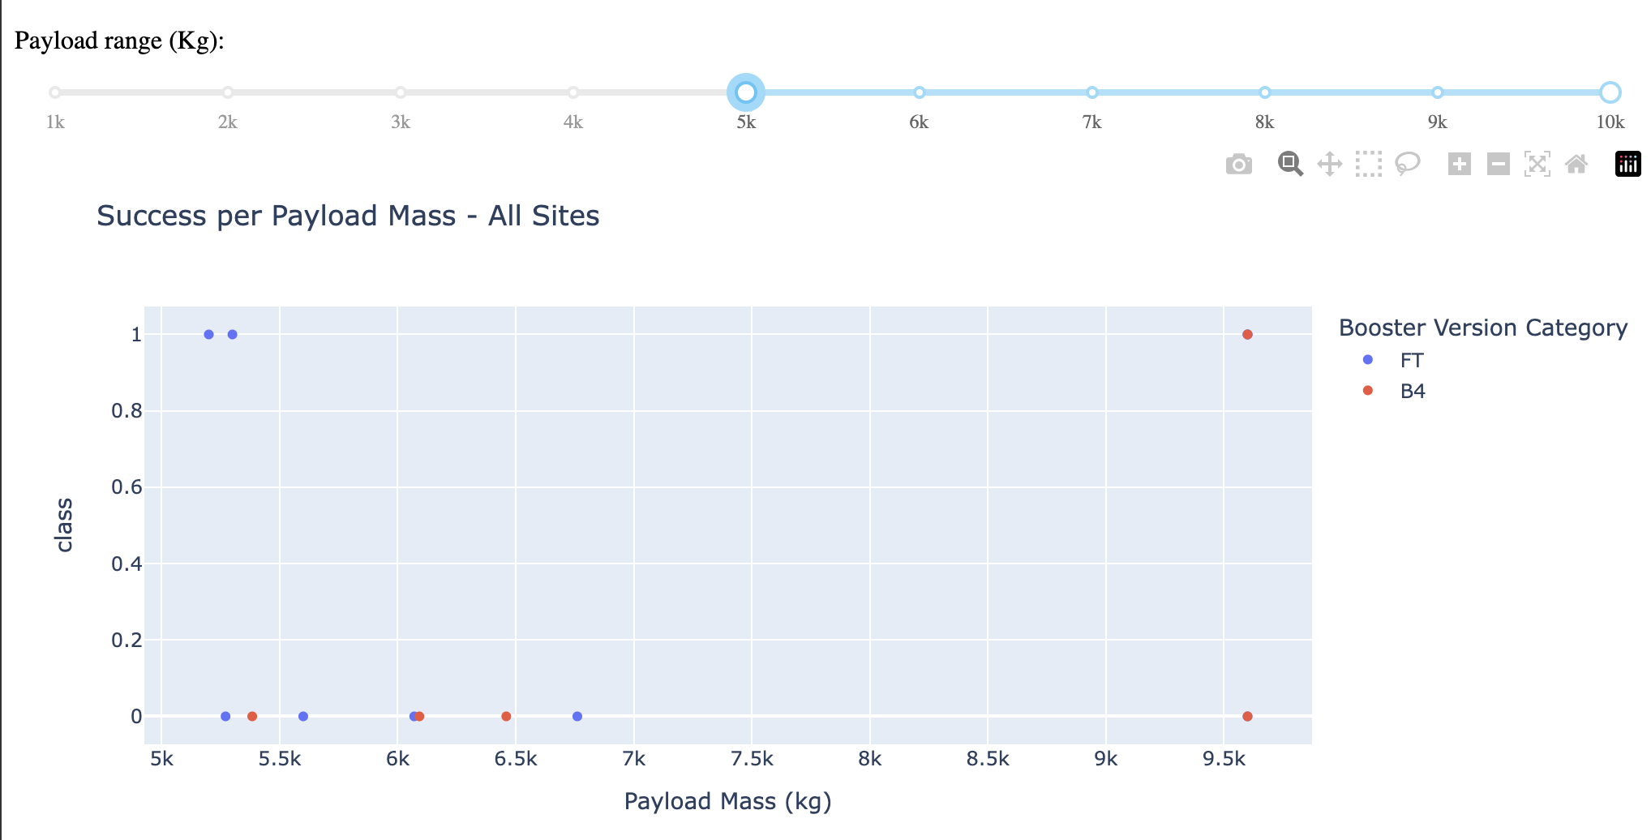
Payload vs. Launch Outcome scatter plot for all sites – 5k-10k payload range
Only the B4 booster was used after a payload size of 7k
FT has the slightly larger failure rate, although it is also used more frequently

Slide 42

Section 5

Slide 43
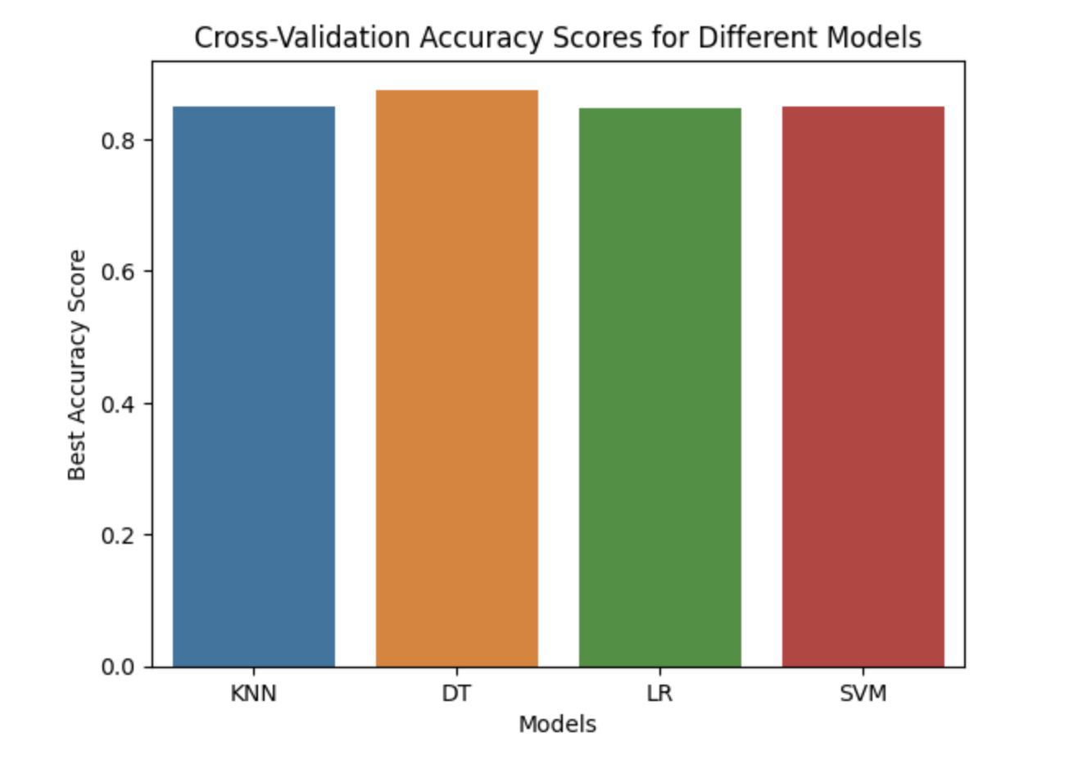
Classification Accuracy
Although all models’ best parameter settings display respectable accuracy scores, decision tree clearly takes the cake with an accuracy of .875

Slide 44
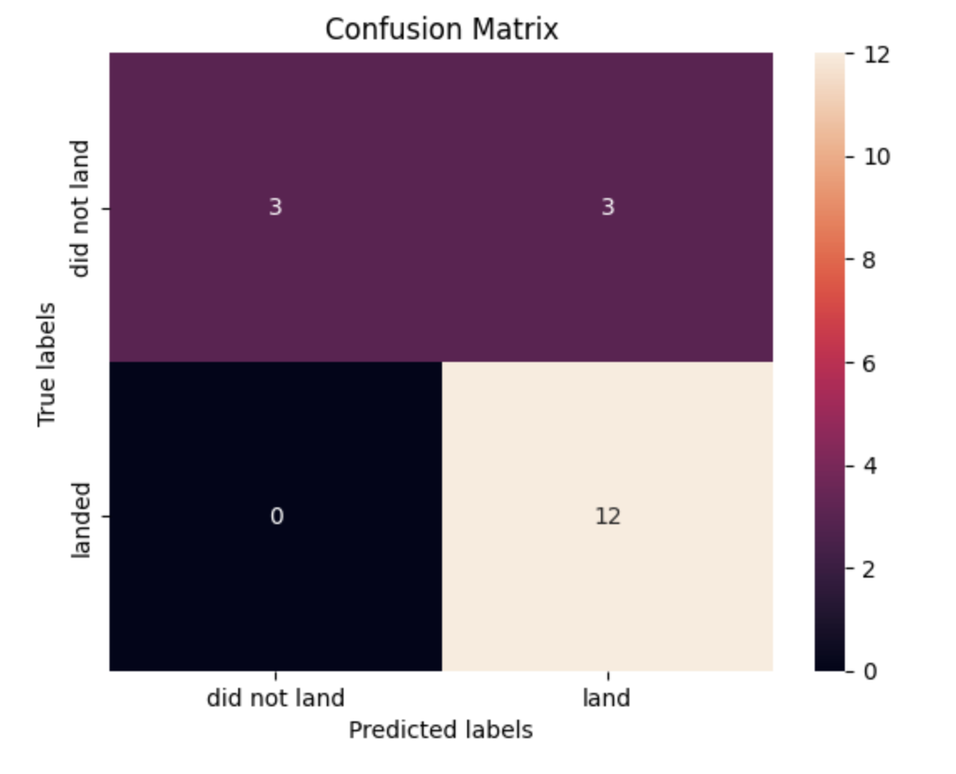
Confusion Matrix
The decision matrix had the highest accuracy while predicting a land 15/18 times. The three times it predicted incorrectly occurred when it predicted a land and that did not occur. Although it predicted a failed landing only three times, it was correct in each prediction.

Slide 45
Conclusions
The first major conclusion to be drawn is that practice is perfect and time is the most important factor in a launch. It was repeatedly seen that at each launch site, the more time that had passed the more likely the flight would be succeed.
The second conclusion would be that some orbits might just be not worth the attempt (financially at least), as five orbits had a success rate of 100%, and the others were all below 50%.
It was also clear that the higher the payload, the far more difficult it would be to complete a successful launch.
Finally, while moving forward it seems to reason to prepare decision tree models for future use. Their accuracy is dependable, and although they are slower to run than other models, in the instance of bidding for +100M dollar projects, the time does not seem to be a major factor.

Slide 46
Appendix
During the project, custom functions provided by the IBM / COURSERA team were used to help its completion: https://www.coursera.org/learn/applied-data-science-capstone/home/info

Slide 47


